Slide 1
Fingerprint spoof detection
Using Sparsity Autoencoaders with Deep learning

Slide 2
Task 1 :
Finding the best configuration of autoencoaders for Features extracted for finger prints
Trained 3 neural nets by concatenating the data of same features from different sensors , Each network for each feature .
By changing the key parameters like hiddenlayes , hidednlayer size ,l2 weight Regularization , Sparcity Regularization , Sparcity Proportion choosing the best set of values from validation and test ROC
After having enough linear equations to fit data i.e( ann ) ,we then need to use the Weightdecay to regularize net and to limit activation we use Sparsity proportion.

Slide 3
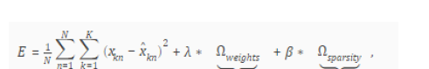

Cost function used in auto encoaders
Sparcity function
Sparsity regularization –row (formula 2)
Sparsity proportion –Beta (formula 1)
L2 weight regularization –omaga weights (formula 1)
We need to know about above parameters before working with Sparsity auto encoders, Which help better tuning the system .

Slide 4
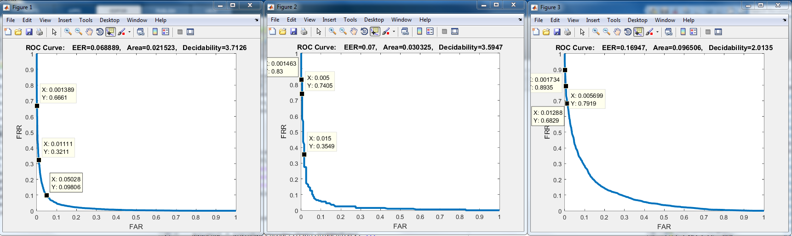
Feature LBP of both sage and digi sensors
Train roc Validation roc Test roc
Configuration used (high accuracy )
hidden Size =400,150
'MaxEpochs',1000 ,400 'L2WeightRegularization',0.5, 0.5
'SparsityRegularization',5,5
'SparsityProportion',0.05, 0.05

Slide 5
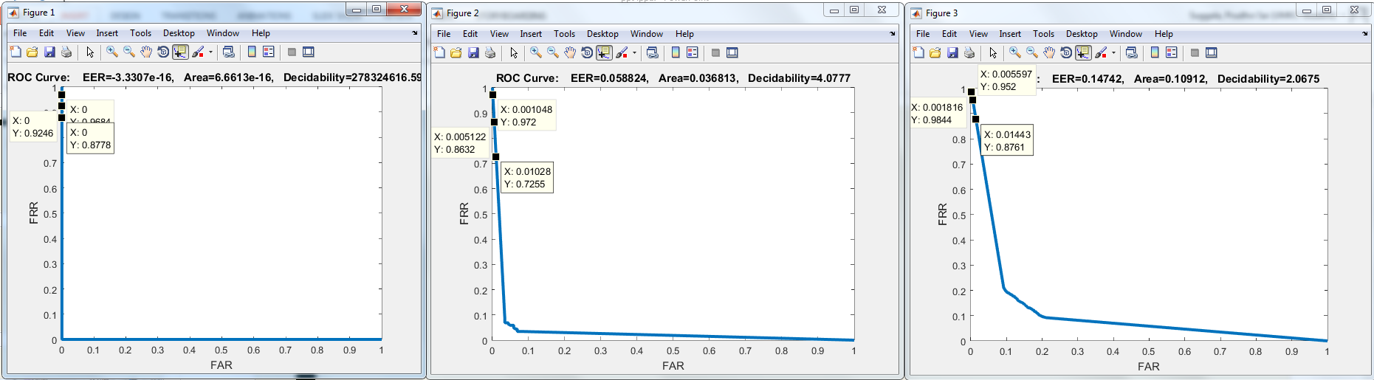
Feature BGP of both sage and digi sensors
Train roc Validation roc Test roc
Configuration used (high accuracy )
hidden Size =350,75
MaxEpochs',600 ,400 ‘
L2WeightRegularization',0.005, 0.05
'SparsityRegularization',2,1
'SparsityProportion',0.06, 0.05

Slide 6
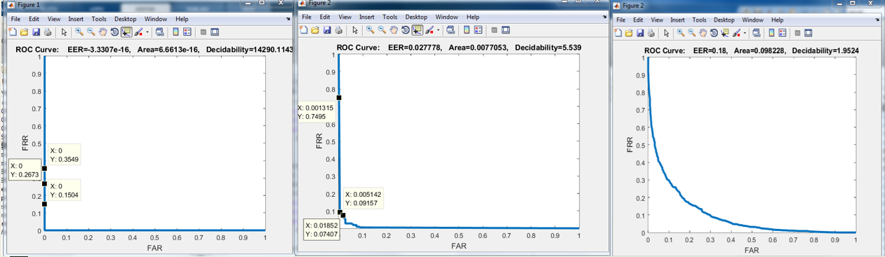
Feature BSIF of both sage and digi sensors
Train roc Validation roc Test roc
Configuration used (high accuracy )
hidden Size =750,200
MaxEpochs',1000,200 ‘
L2WeightRegularization',0.5, 0.05
'SparsityRegularization',2,1
'SparsityProportion',0.06, 0.05

Slide 7
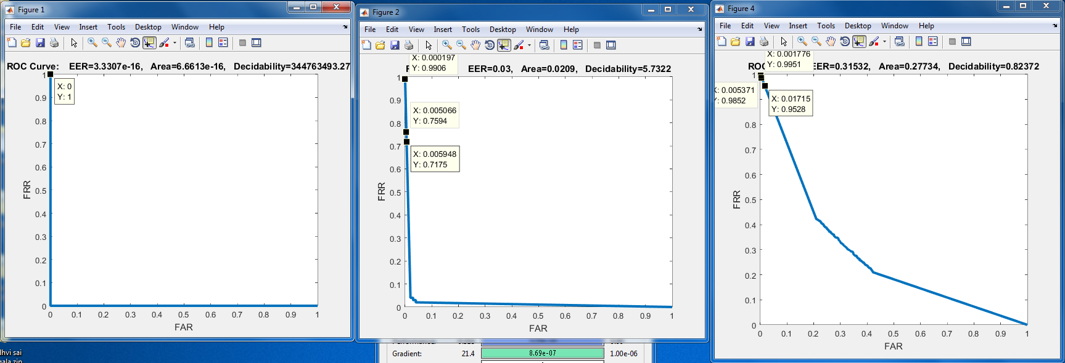
Task 2 test : DigiBGP train :SageBGP same configuration as BGP task 1
Train roc Validation roc Test roc

Slide 8
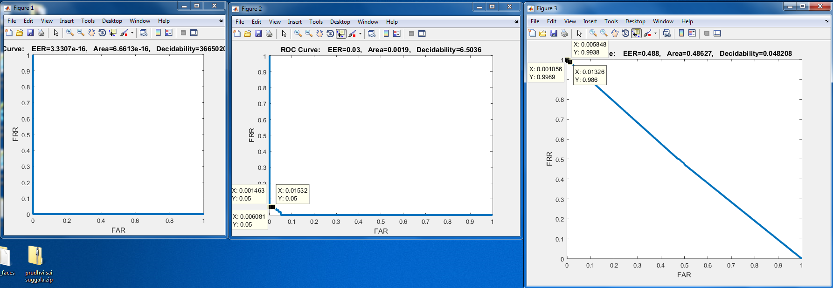
Task 2 test : sage BGP train : Digi BGP same configuration as BGP task 1
Train roc Validation roc Test roc

Slide 9
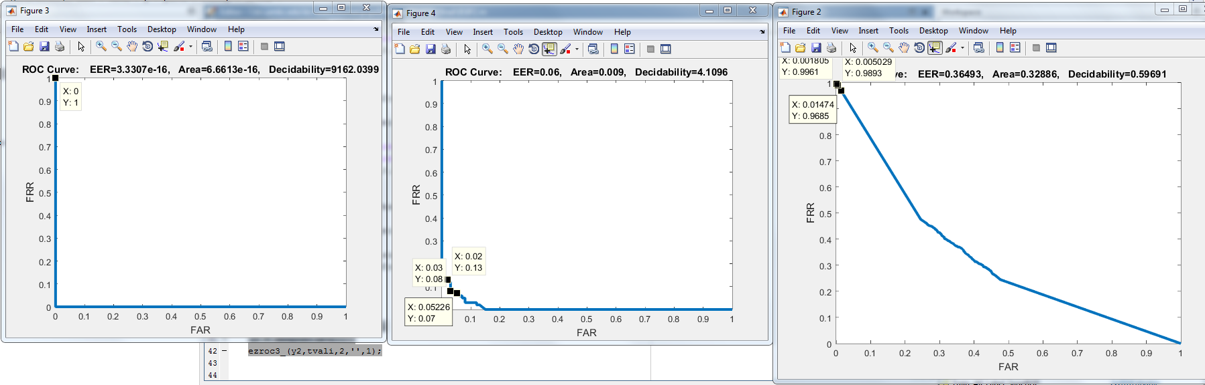
Task 2 test : DigiBSIF train :SageBSIF same configuration as BGP task 1
Train roc Validation roc Test roc

Slide 10
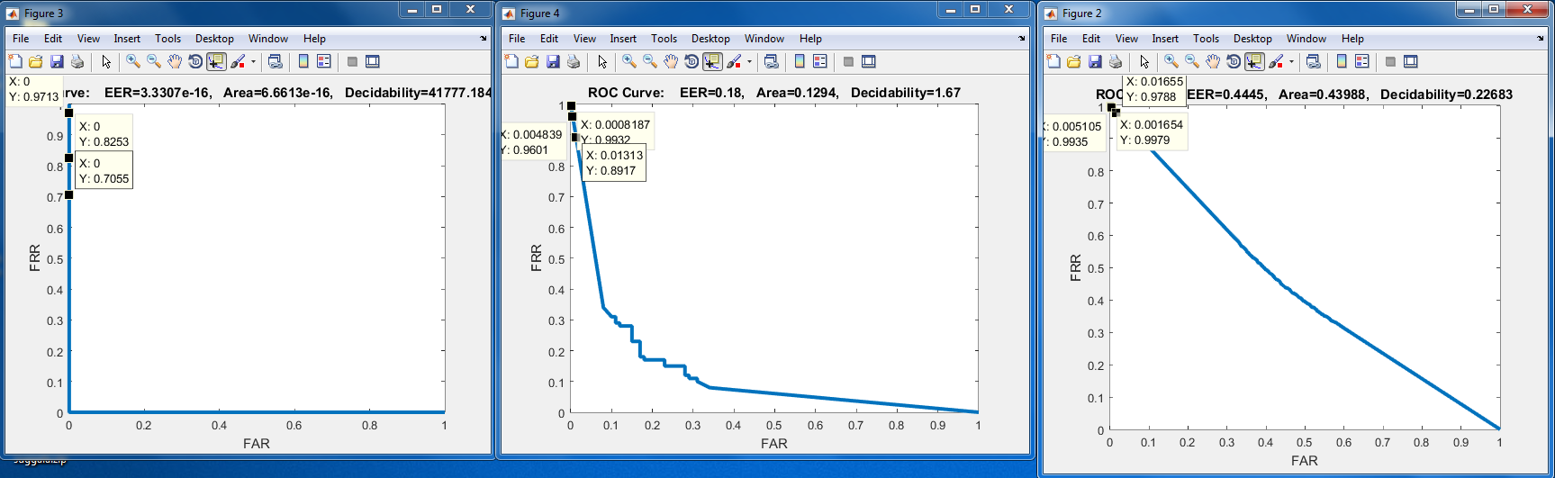
Task 2 test : Sage BSIF train :Digi BSIF same configuration as BGP task 1
Train roc Validation roc Test roc

Slide 11
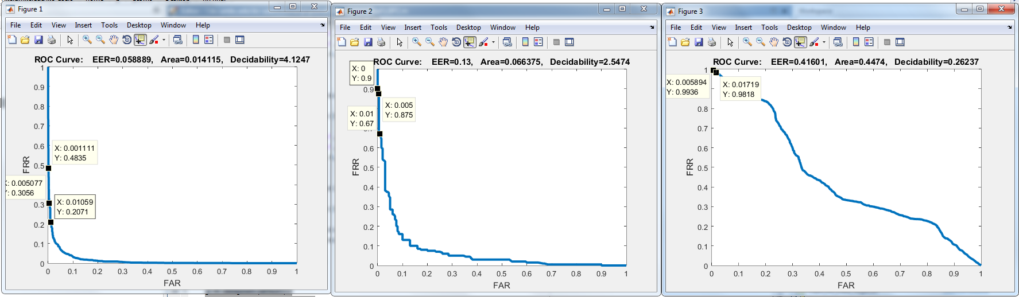
Task 2 test : Sage LBP train :Digi LBP same configuration as BGP task 1
Train roc Validation roc Test roc

Slide 12
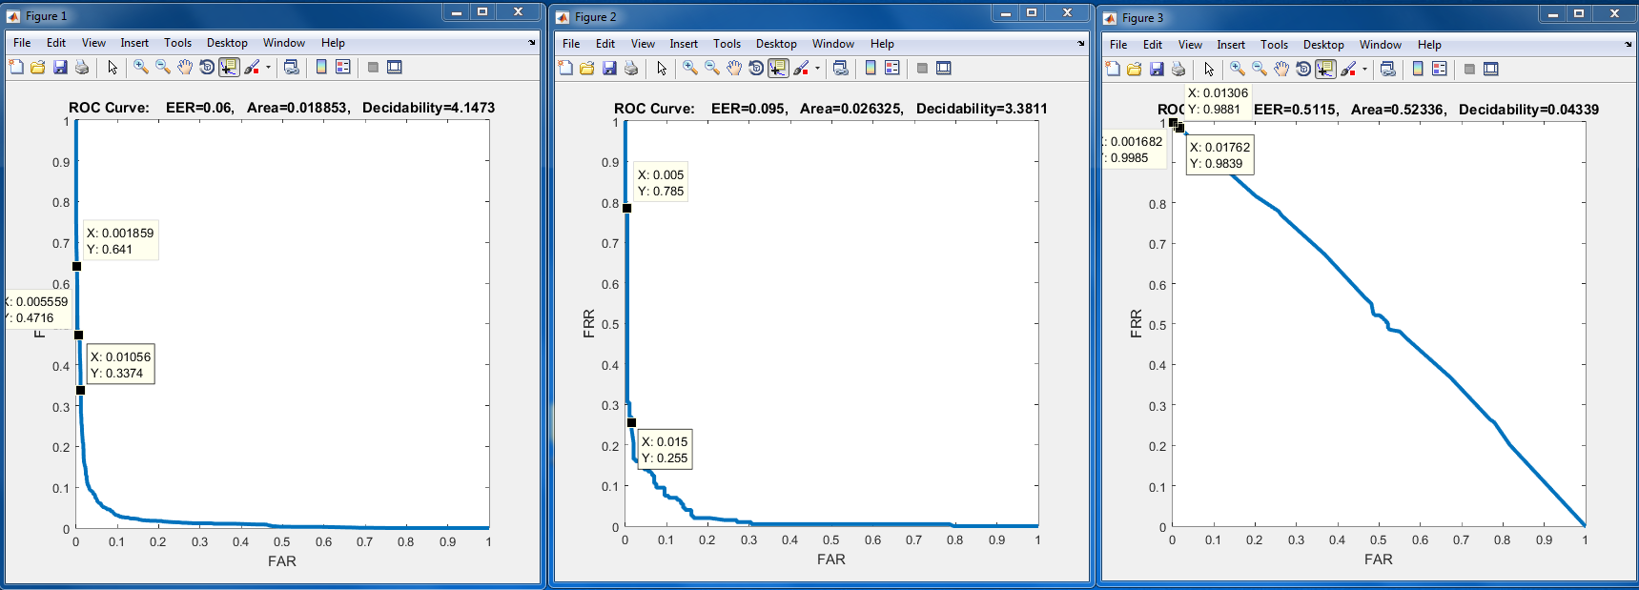
Task 2 test : DIGI LBP train :SAGE LBP same configuration as BGP task 1
Train roc Validation roc Test roc

Slide 13
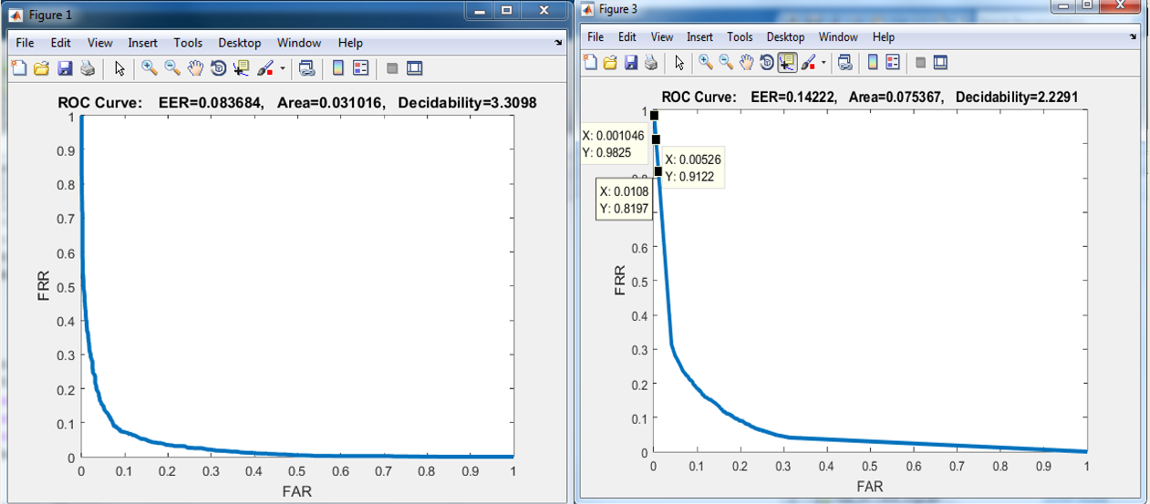
Feature level data fusion
Roc’s of net trained with : [digi LBP and digi BGP]

Slide 14
Conclusion
L2 Weight regularization technique i.e Weight decay is used as low as 0.004 but for in task 1 .I had taken a high value of .5 but that had resulted in Good ROC curve. It make a sense that most of weights need to be zero and different patterns are capture different ANN’s
Sparsity proportion helps in defining the number of neural nets needs to be activated on a particular time. The lesser the number proportion increases the performance.
Though we have large number hidden layers than the data that even help to find the special patterns under training a network in regularized way
In case of a finger print spoof detector system you to concentrate on which type of sensor used at enrolment and at time of verification.
May be finding a transfer function that converts data from all vendors to a space where all are equal that can flawlessly work in real-time scenario.
Feature Fusion technique propose in task 3 help to increase the accuracy when data from same digi with combination of LBP and BGP as features.

